Slide 1
Software Engineering and Architecture
SCM Examples Subversion and Git

Slide 2
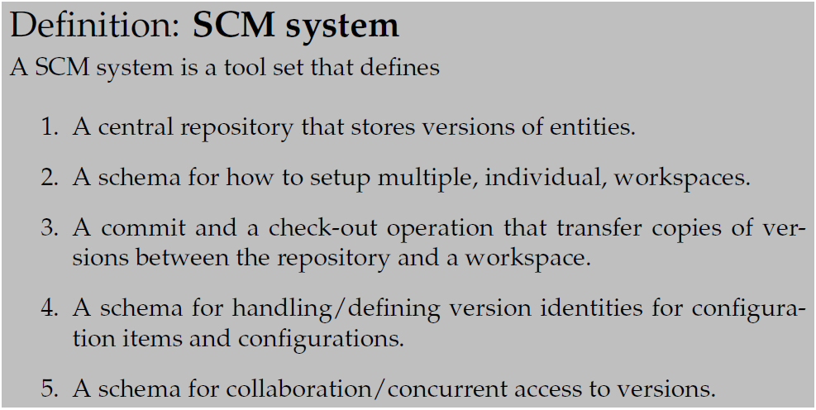
The SCM Template

Slide 3
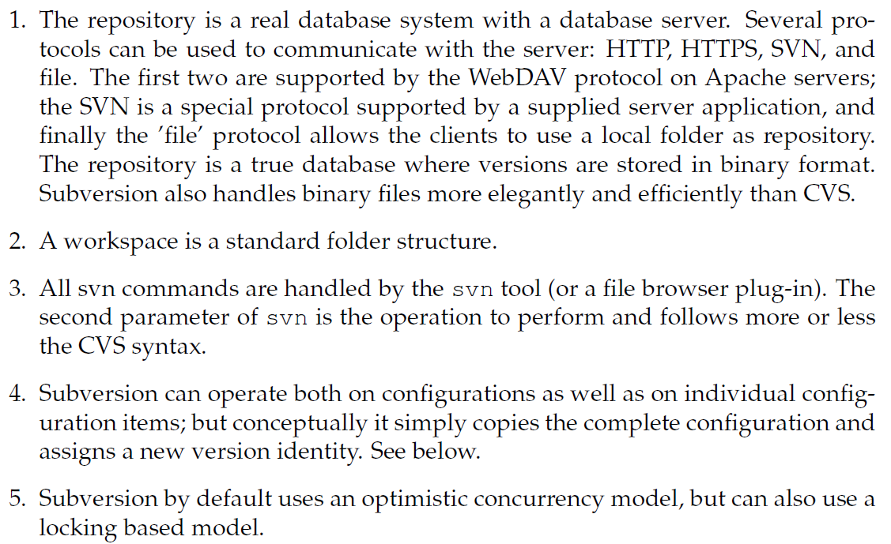
Subversion

Slide 4
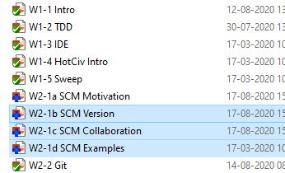
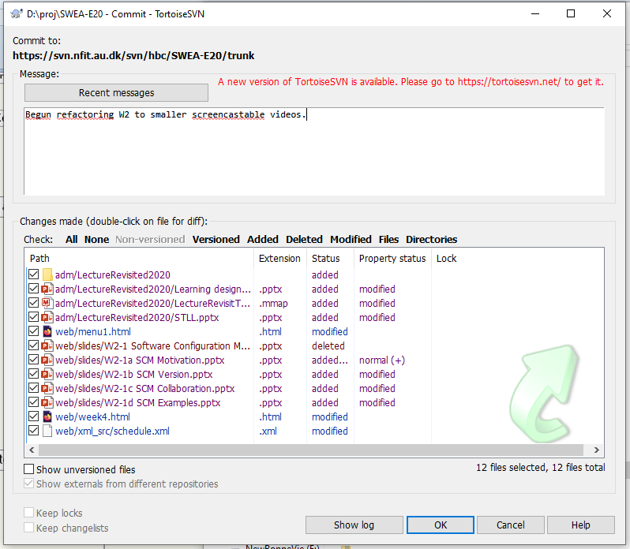
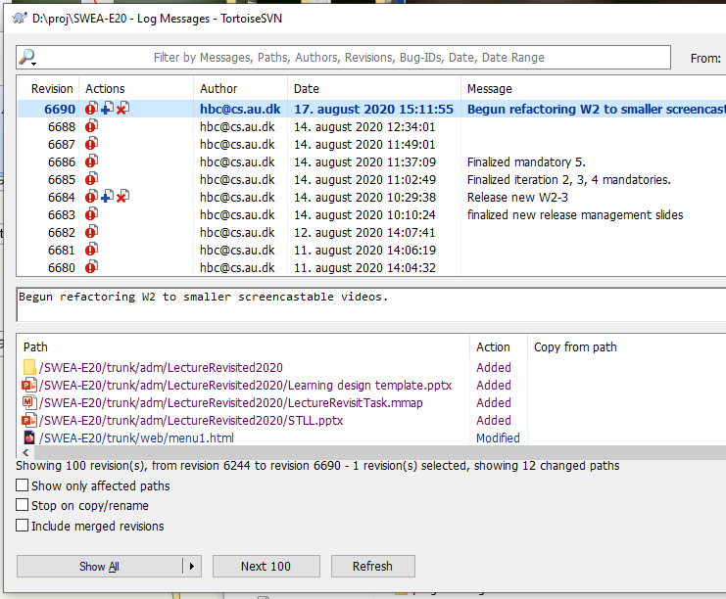
Examples

Slide 5
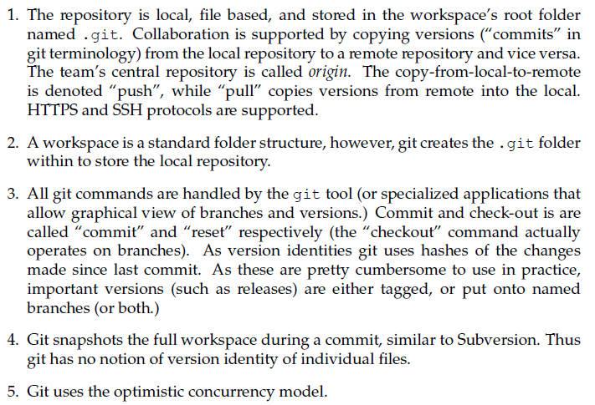
Git

Slide 6
Git Dist. Repository
Git is a Distributed SCM system
Every workspace holds a complete copy of the repo*
‘git commit’ makes a check-in/commit
But to the local repository (gobbling up your disk space!)
Thus we cannot collaborate? Yes we can because we can
Push: Copy all changes from local repo to remote repo
Pull: Copy all changes from remote repo to local repo
*) Not quite true: complete copy of subset of branches

Slide 7
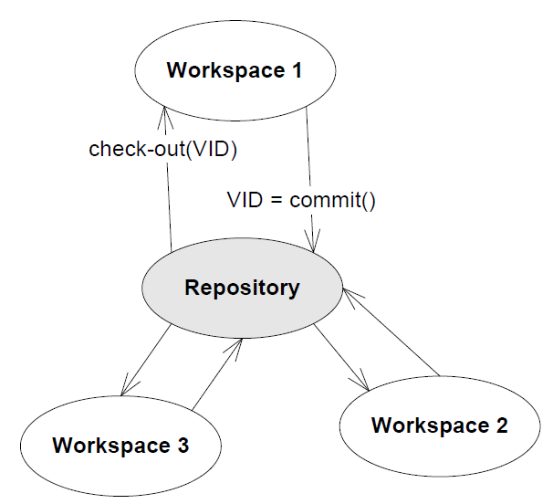
Multiple Repositories
The ‘common’ one is called origin
Typically hosted at AU GitLab, BitBucket, GitHub, …
They can naturally form a chain
Local – Team – Company
Exercise:
Pros?
Cons?
Local Repo
Local Repo
Local Repo

Slide 8
Git Staging Area
One further complication
A modified file in workspace is not considered modified until it is added to the Git staging area
Thus the procedure is as this
Arne modifies hans.txt
Arne adds it to the staging area by ‘git add hans.txt’
Arne commits to local repo: ‘git commit –m ”modified hans”’
Arne pushes to remote repo: ‘git push’
Subversion equivalent
Arne modifies hans.txt
Arne commits: ‘svn commit –m ”modified hans”’

Slide 9
Why?
The staging area (aka index) adds one extra layer of complication to the use of git.
Why?
Fine-grained version control
Scenario:
In iteration 755 I
Add feature x to my fabulous program
… which uses the ‘doSuperStuff’ method that I spotted a bug in!
Git
Add just the files related to bug fix to index; commit bugfix
Add rest of files to index; commit feature

Slide 10
Summary
Why?
To enable
Release management and historical tracking
Collaboration in the team
How?

